Slide 1
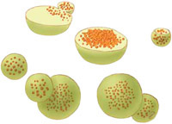


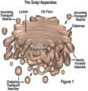
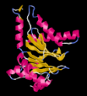


facebook
Wall
Photos
Me
Sources
Lysosome
Logout
Lysosome is preparing to “explode!”
Wall
Info
Photos
Boxes
Write something…
Share
View photos of Lysosome
Send Lysosome a message
Lysosome I have so much more digesting yet to be done, shout out to all enzymes, PLEASE work fast!!
October 7, 2010
Poke
Cytoplasm just checking up on one of my many buddies that I carry around
October 1, 2010
Information
Networks:
In the Cytoplasm
Birthday:
1949
Political:
Independent Party
Religion:
No denomination
Hometown:
Belgium
Lysosome found a foreign object, “I told you I was coming”
June 11, 2010
Lysosome tells all foreign objects, “GET OUT, before I have to digest you!”
October 28, 2010
Friends
Lysosome wants to thank all of my trusty enzymes, including: proteases, nucleases, and phopholipases for all the hard work they do, very much appreciated.
September 9, 2010
Golgi Apparatus
Proteases
Cytoplasm
Lysosome is taking out the “trash”
April 17, 2010
Nucleases
Phospholipases

Slide 2
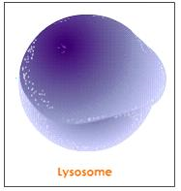
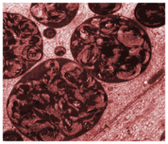
facebook
Wall
Photos
Me
Sources
Lysosome
Logout
Lysosome is preparing to “explode!”
Wall
Info
Photos
Boxes
Basic Information
Networks: In the cytoplasm
Sex: None Specified
Birthday: 1949
Hometown: Belgium
Relationship Status: It’s Complicated
Political Views: Independent Party
Religious Views: No denomination
View photos of Lysosome (10)
Send Lysosome a message
Poke
Personal Information
Information
Activities: Disposing of waste, digest foreign materials, transports undigested material for removal
Interests: Being a garbage disposal and garbage man
Favorite Music: I wanna be a Lysosome, The Cell Song
Favorite Movies: Lysosomes, The Magic School Bus Goes Cell-ular
Favorite TV Shows: Bill Nye : The Science Guy, Dr. Oz, Sid the Science Kid,
Favorite Books: Lysosomes, Biology of the Lysosome,
Networks:
In the Cytoplasm
Birthday:
1949
Political:
Independent Party
Religion:
No denomination
Hometown:
Belgium
Photos
Contact Information
2 Albums
Address: 1234 Cytoplasm Lane, Cellville CW 12345
Phone Number: (111) 123-4567

Slide 3
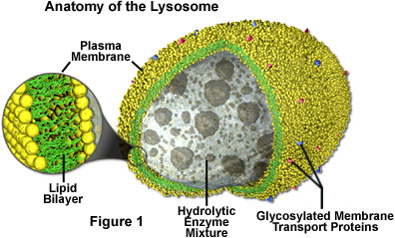
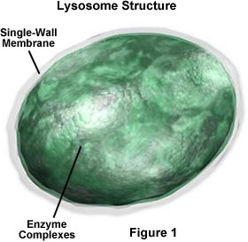
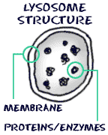
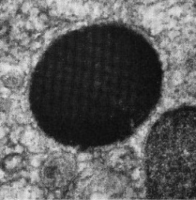
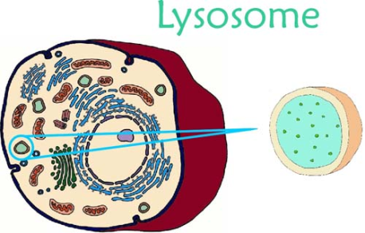


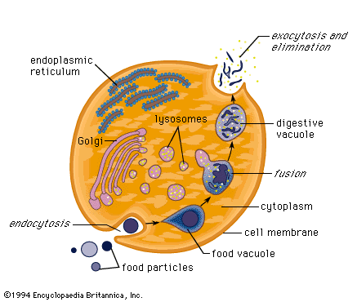
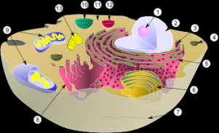
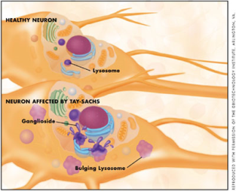
facebook
Wall
Photos
Me
Sources
Lysosome
Logout
Lysosome is preparing to “explode!”
Wall
Info
Photos
Boxes
Photos of Lysosomes7 Photos
Tagged Photos

Slide 4
WHAT YOU SHOULD KNOW ABOUT ME
MADE OF:
Over 40 enzymes like the proteases, nucleases, and phospholipases
FUNCTION:
Transports undigested material for removal
Vary in shape depending on process being carried out
Cell breaks down if I explodes
Breaks down foreign material that enter a cell
MISCELLANEOUS:
My Name means “releasing body”
Eats my way through egg—entrance to sperm
Discovered by Christian de Duve
RESOURCES USED:
1)http://publications.nigms.nih.gov/insidethecell/images/ch1_lysosome.jpg
2) http://library.thinkquest.org/12413/structures.html
3) http://library.thinkquest.org/C004535/lysosomes.html
4)http://www.seorf.ohiou.edu/~tstork/compass.rose/cell.03/golgi/lysosome.html
5)http://sln.fi.edu/qa97/biology/cells/cell7.html
6)http://www.csd509j.net/cvhs/staff/heem/adv_bio/...cell.../Lysosome.pp%20is%20the%20website
7) http://projects.edtech.sandi.net/miramesa/Organelles/lyso.html

